Slide 1



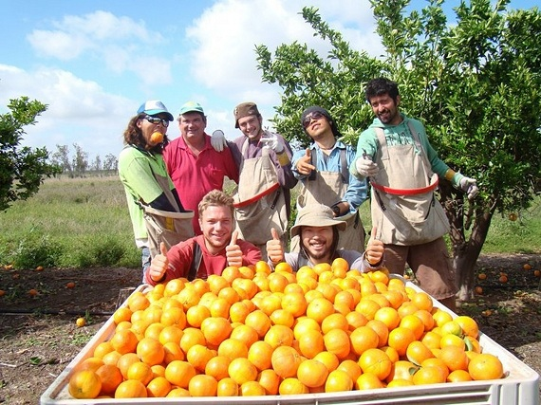


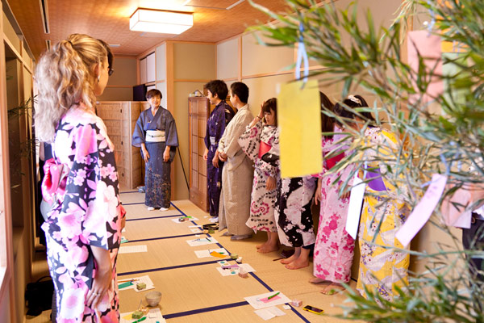

Slide 2

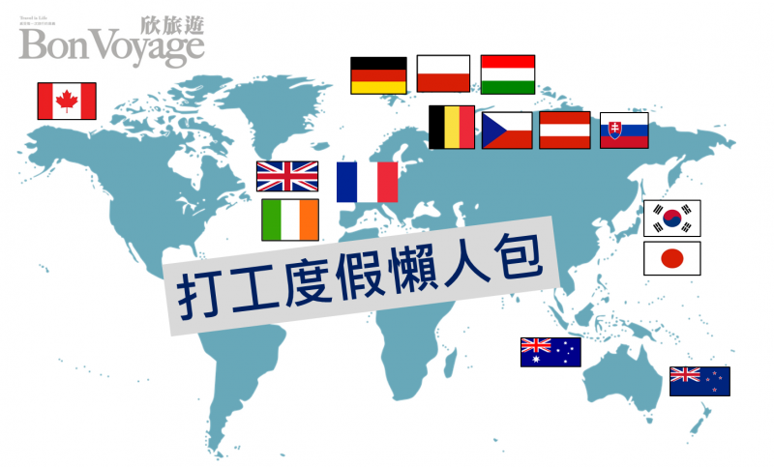

Slide 3







Contry | Age | Quota | Review | Valid Visa
Australia | 18-30 | Unlimited | x | 2 years
New zealand | 18-30 | 600 | x | 1 year
Japan | 18-30 | 5000 | Y | 1 year
Korea | 18-30 | 600 | x | 1year
Canada | 18-35 | 1000 | Lottery | 1year
UK | 18-30 | 1000 | Lottery | 2years
France | 18-30 | 500 | Documentary | 1year

Slide 4





How much time can you learn language?
When to start?
Listen to other people's experience.
Be familiar with process and tips.

Slide 5


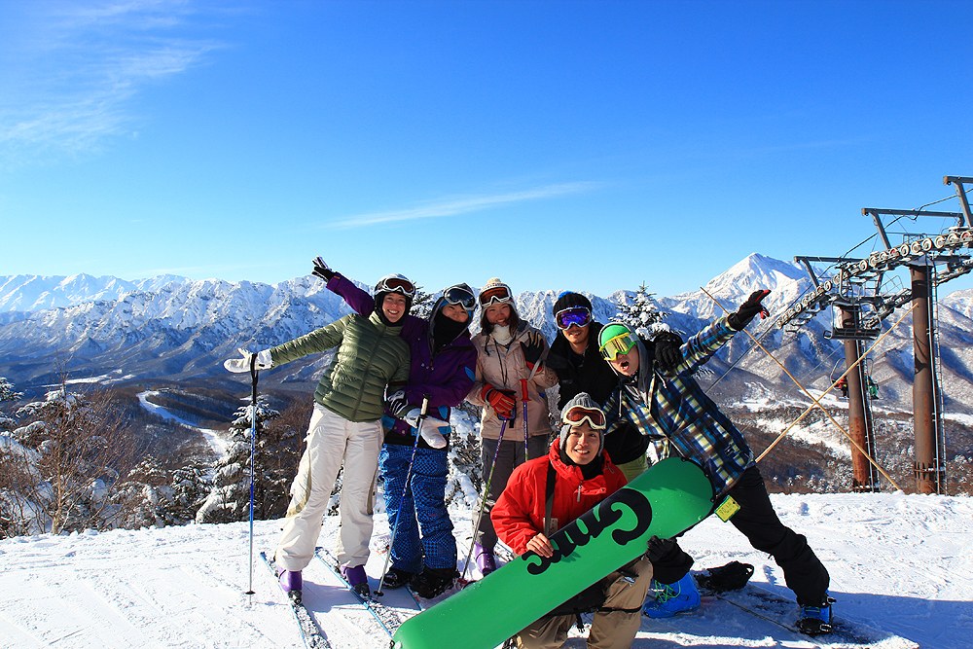
Give
yourself
a chance
to
be
brave.

Slide 6



